Slide 1

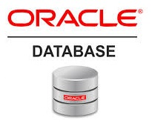
Oracle database
Lecture 33

Slide 2

Today’s Agenda
Understanding Privileges
System Privileges
Object Privileges
Grant Command
Revoke Command
Roles
Removing Roles

Slide 3
Understanding Privileges
A privilege is a right to execute a particular type of SQL statement.
There are two types of privileges: SYSTEM PRIVILEGES and OBJECT PRIVILEGES.

Slide 4
Understanding Privileges
An example of a SYSTEM PRIVILEGE is the right to create a table or an index.
A particular OBJECT PRIVILEGE allows us to access an individual object, such as the privilege to SELECT from the EMP table, to DELETE from the STUDENTS table, or to SELECT a number from a specific sequence.

Slide 5
System Privileges
To establish a connection to the database, a user must be granted certain SYSTEM PRIVILEGES.
These privileges are granted either individually or in the form of roles.
Remember that a role is a collection of privileges.

Slide 6
System Privileges
Although the user INDIAN has been created, but it cannot start a session, as we see from the following error message.
The user lacks the CREATE SESSION SYSTEM PRIVILEGE to log in to the database.

Slide 7
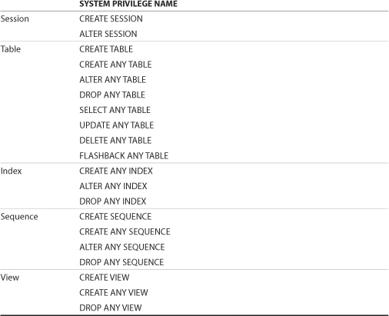
List Of Common System Privileges

Slide 8
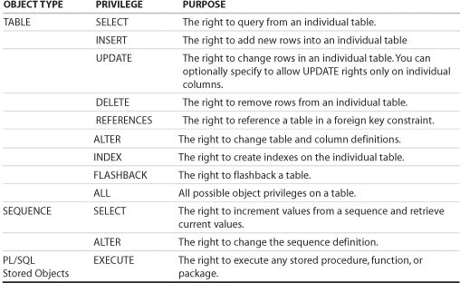
Object Privileges
Object privileges are granted for a particular object (for example, table, view, sequence).

Slide 9
The GRANT Command
We give a system privilege or an object privilege to a user by using the GRANT command.
The syntax for granting system privileges is as follows:
GRANT <list_of_privileges>
TO <user_name>;

Slide 10
The GRANT Command
The following statement grants the CREATE SESSION and CREATE TABLE system privilege to the INDIAN user.
GRANT CREATE SESSION,CREATE TABLE
TO INDIAN;
This allows the INDIAN user to establish a session to the database and create tables.

Slide 11
Granting Object Privilege
Object privileges grant certain privileges on specific objects, such as tables, views, or sequences.
We can grant object privileges to other users when we want them to have access to objects we created.
We can also grant the user , access to objects , we do not own if the object’s owner gives us permission to extend rights to others.

Slide 12
Granting Object Privilege
The following is the general syntax for granting object privileges.
GRANT <list_of_privileges>
ON <resource_name>
TO <user_name>
[WITH GRANT OPTION];

Slide 13
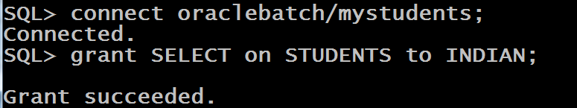
Granting Object Privilege
For example, the following statement connects as the ORACLEBATCH user account and grants the SELECT privilege on the STUDENTS table to the new user INDIAN.
In this case, the ORACLEBATCH user is the grantor, and INDIAN is the grantee, the recipient of the privileges.
Now the INDIAN user can query the STUDENTS table.

Slide 14
Granting Object Privilege
In addition to SELECT, other object privileges can be granted on a table, such as INSERT, UPDATE, DELETE, ALTER, INDEX, and REFERENCES .
The ALTER privilege allows another user to change table definitions with the ALTER table command, the INDEX privilege allows the creation of indexes on the table, and the REFERENCES privilege allows the table to be referenced with a foreign key constraint.
We can also grant all object privileges at once by using the GRANT ALL command.

Slide 15
Granting Object Privilege
We can grant UPDATE privilege on individual columns on a table.
For example, to grant UPDATE on the columns ENAME and JOB of the EMP table, we can execute the following command.
GRANT UPDATE (ename, job) ON EMP TO INDIAN;

Slide 16
Extending Privilege To Others
We can extend or further grant the privilege to the resources on which we have got the privilege to other users
But for this we must have received the privilege to pass it on to others through WITH GRANT OPTION.

Slide 17
Extending Privilege To Others
The following SQL statement grants all object privileges on the EMP table to the INDIAN user.
It also passes to the INDIAN user the ability to grant these privileges to yet other users, using the WITH GRANT OPTION.
GRANT ALL ON EMP TO INDIAN WITH GRANT OPTION
Here, INDIAN is the grantee but can become a grantor if the privilege is passed on to another user.

Slide 18
Extending Privilege To Others
To allow users to pass on SYSTEM PRIVILEGES to other users, we must have been granted the SYSTEM PRIVILEGE with WITH ADMIN OPTION or have been granted the GRANT ANY PRIVILEGE SYSTEM PRIVILEGE.
For example, after execution of the following statement, the user INDIAN can grant the CREATE SESSION SYSTEM PRIVILEGE to other users.
GRANT CREATE SESSION TO INDIAN WITH ADMIN OPTION

Slide 19
The REVOKE Command
Privileges can be taken away with the REVOKE command.
The syntax for revoking system privileges is as follows:
REVOKE <list_of_privileges>
FROM <user_name>;

Slide 20
The REVOKE Command
The following statement revokes the CREATE SESSION SYSTEM PRIVILEGE from the INDIAN user.
REVOKE CREATE SESSION FROM INDIAN;
This prohibits the INDIAN user from establishing a session to the database.

Slide 21
The REVOKE Command
Object privileges can also be taken away with the REVOKE command.
The syntax for revoking object privileges is as follows:
REVOKE <list_of_privileges>
ON <resource_name>
FROM <user_name>;

Slide 22
The REVOKE Command
The following statement revokes the UPDATE privilege on EMP from the INDIAN user.
REVOKE UPDATE ON EMP FROM INDIAN;
This prohibits the INDIAN user from updating the EMP table.

Slide 23
An Important Point
Object privileges granted using the WITH GRANT OPTION are revoked if the grantor’s object privilege is revoked.
For example, assume that USER1 is granted SELECT privilege on the EMP table, using the WITH GRANT OPTION, and he grants the same privilege to USER2.
If the SELECT privilege is revoked from USER1, then the revoke cascades to USER2.

Slide 24
Role
A role is several privileges collected under one name.
Using roles aids in administration of multiple privileges to users.
Oracle includes predefined roles; three popular ones that contain a number of different system privileges are CONNECT, RESOURCE, and DBA.

Slide 25
Role
The CONNECT role contains the CREATE SESSION system privilege that allows a user to start a session
The RESOURCE role allows a user to create tables and indexes on any tablespace as well as create PL/SQL packages, procedures, functions etc.
The DBA role includes all system privileges. This role is usually granted to a user who performs database administration tasks

Slide 26
Role
When a user is granted a role, the user acquires all the privileges defined within the role.
The following statement uses the two predefined Oracle roles CONNECT and RESOURCE to grant a number of system privileges to the new user.
GRANT CONNECT, RESOURCE TO INDIAN;

Slide 27
User Defined Roles
In addition to using Oracle’s predefined system privilege roles we can create user-defined roles to customize a grouping of system and/or object privileges.
There may be different types of users for a given system:
Sometimes, there are users who only view data, so those users need only SELECT privileges.
There are other users who maintain the data, and they typically need a combination of SELECT, INSERT, UPDATE, and DELETE privileges on certain tables and columns.

Slide 28
User Defined Roles
In such cases we can create roles , add privileges to those roles as per requirement and finally assign these roles as needed to users.
The syntax to create a role is as follows.
CREATE ROLE ROLENAME ;
The following statement creates a role named READ_DATA for users who only need to query the data in the ORACLEBATCH schema.
CREATE ROLE READ_DATA;

Slide 29
Adding Privileges To Role
However , the role still does not have any privileges associated with it.
So to add privileges to a role we use following syntax:
GRANT <list_of_privileges>
ON <resource_name>
TO <role_name>;
For example:
GRANT SELECT
ON EMP
TO READ_DATA;

Slide 30
Granting Role To Users
The next step is to grant the READ_DATA role to users so these users have the privileges defined by the role.
The following statement grants this role to the user INDIAN.
GRANT READ_DATA TO INDIAN;
Now the user INDIAN has SELECT privileges on EMP table of ORACLEBATCH schema.

Slide 31
Revoking Roles
We can revoke role from a user by using the following REVOKE command.
REVOKE READ_DATA FROM INDIAN;

Slide 32
Revoking Privileges From Roles
If we want none of the users to have the SELECT privilege to the EMP table anymore, then we can revoke this privilege from the individual role only, and all users that have been granted this role will no longer have the ability to query the table.
Syntax:
REVOKE <list_of_privileges>
ON <resource_name>
FROM <role_name>;
Example:
REVOKE SELECT ON EMP FROM READ_DATA;

Slide 33
Removing Roles
We drop roles by using the DROP ROLE command.
DROP ROLE READ_DATA;

